Slide 1
Module 10
Control & Protection

Slide 2
What can a converter control?
Control values of the fast control loop:
DC voltage
DC current
AC current
Positive phase active current i_{p,psf}
Positive phase reactive current i_{q,psf}
Negative phase active current i_{q,nsf}
Negative phase reactive current i_{q,nsf}
AC voltage
AC frequency
Converter energy

Slide 3
Energy flow
Converter has only a limited energy storage capability, so that during the steady state operation the energy of the converter must be balanced over one period
The energy balancing can be done either through the AC side or through the DC side
One side of the converter defines the power flow, the other side is responsible for the balancing

Slide 4
Basic Control Principle of the HVDC Converter
Control system consists of three major control loops:
AC loop
DC loop
Inner loop
Impedances of the control loop:
AC converter impedance
DC converter impedance
AC grid impedance
DC line impedance
Converter internal impedance

Slide 5
AC current control
Control input / Control reference:
w_{conv}
i_{p} / P
Control output:
U_{dc}
Scenario:
AC power is defined by the operator
DC voltage is used to control the power flow on the DC side to balance the converter energy

Slide 6
AC voltage control
Control input / Control reference:
w_{conv}
U_{AC}
f_{AC}
Control output:
U_{dc}
Scenario:
AC power is defined by the AC load
DC voltage is used to control the power flow on the DC side to balance the converter energy

Slide 7
DC voltage control
Control input / Control reference:
w_{conv}
U_{DC}
Control output:
i_{p}
Scenario:
Station defines the voltage on the DC line
AC current (and therefore AC power) is used to balance the converter energy

Slide 8
Reactive power control
In control modes without AC voltage and frequency control, the reactive power can be controlled independently if the energy balancing
The reactive power does not require DC power flow and can operate without DC line connected

Slide 9
AC control
 | AC current source | AC voltage source
 | Grid Following (GFL) P/Q – control mode | V/f or Grid Forming (GFM)
Primary Control Parameters | Active current Reactive current | AC frequency AC voltage
Secondary Control Parameters | Active power Reactive power
 | AC voltage
Grid application | SCL ≥ 2 | SCL < 2

Slide 10
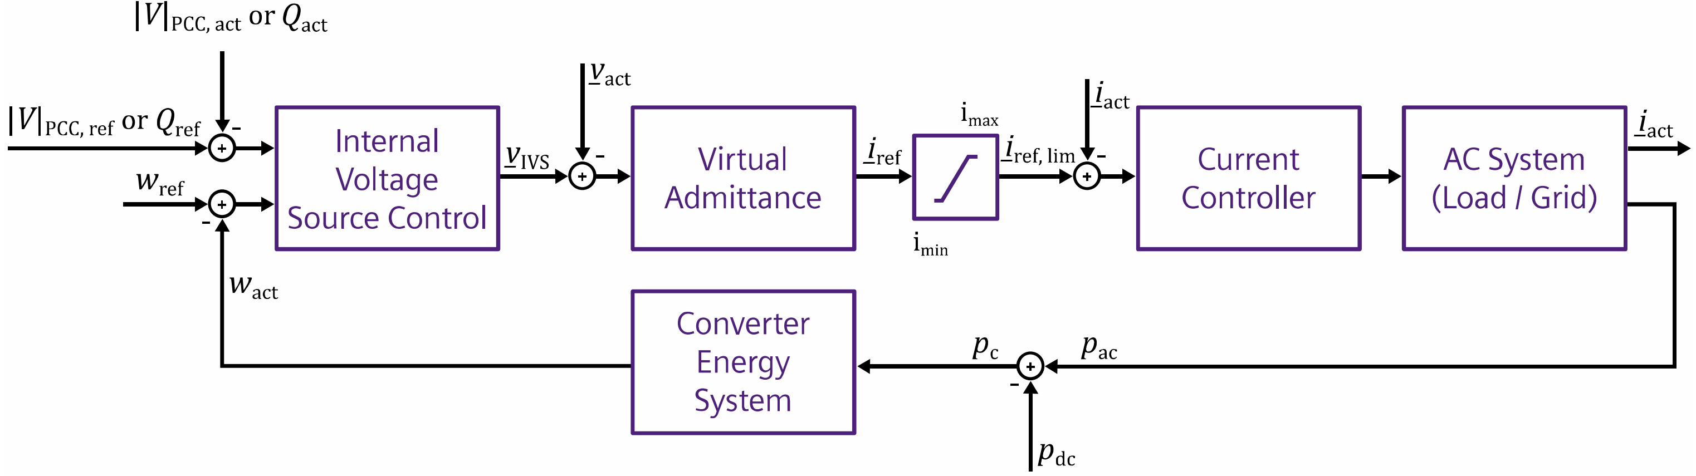
Grid Forming Control Concept
Grid-forming Converters
Advantages of grid-forming control in HVDC and FACTS applications
White paper
Siemens Energy

Slide 11
Steady State power transmission
One station controls DC voltage
One station controls active power
Two active power control modes are possible
P/Q – Control mode
U/f – Control mode

Slide 12
Steady State control principle
Standard Operation
Station which sees the highest DC voltage controls the DC voltage
Active power can be defined at any station
Wind Farm connection
Rectifier receives power coming from WTG
Inverter needs to consider the DC line voltage drop
Rectifier receives power coming from WTG
Inverter needs to consider the DC line voltage drop

Slide 13
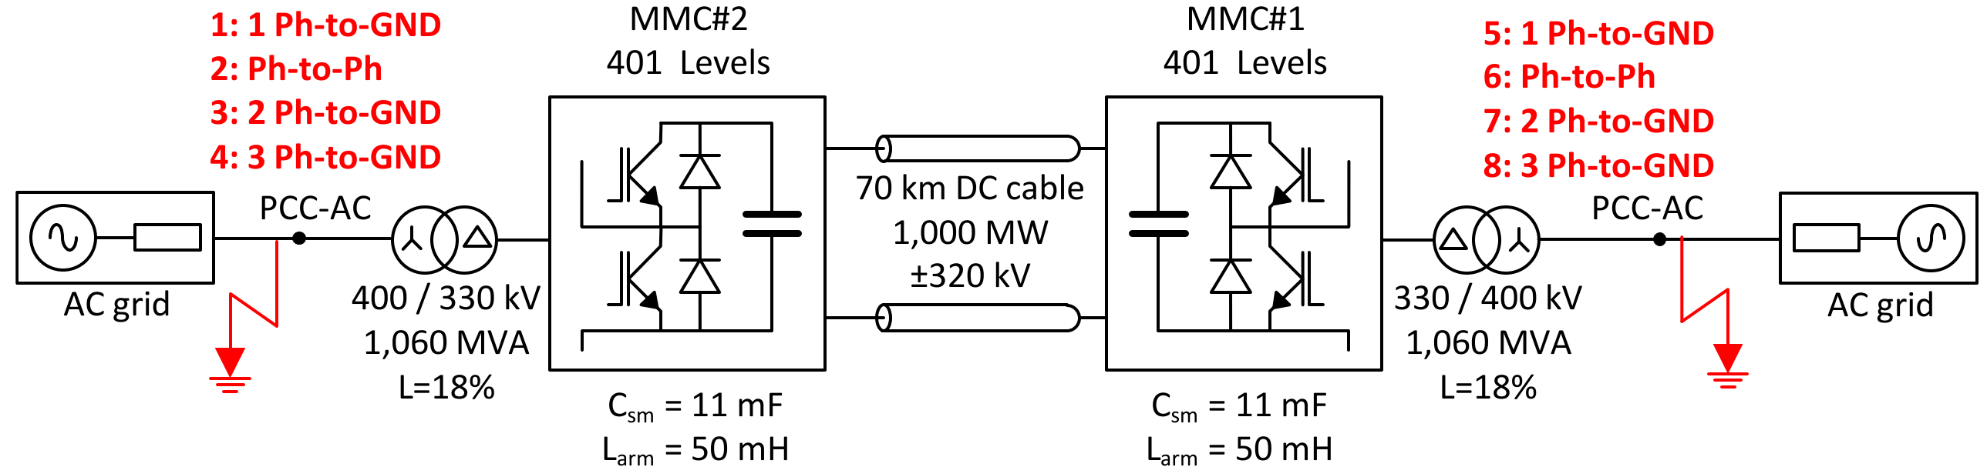
Dynamic Analysis
Dynamic Analysis covers converter behaviour during AC grid faults (faults on the network side of the converter transformer)
AC grid faults are very common, so that the converter must stay connected to the grid and is required to provide supporting functions
CIGRÉ TB 832: GUIDE FOR ELECTROMAGNETIC TRANSIENT STUDIES INVOLVING VSC CONVERTERS

Slide 14
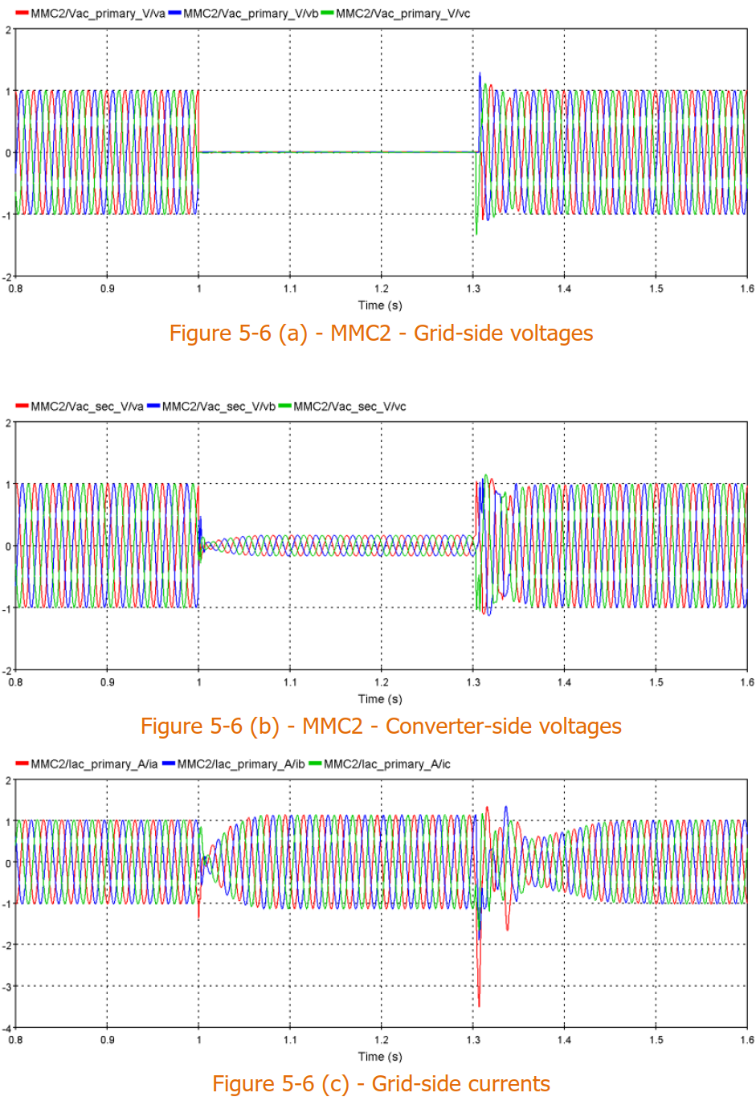
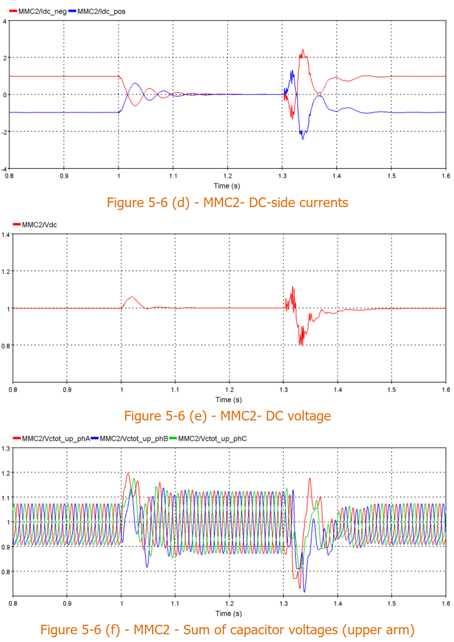
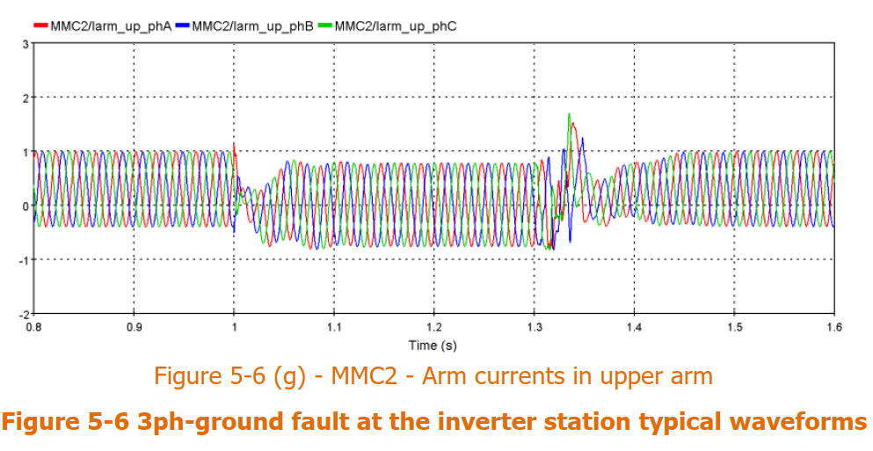
Dynamic Analysis: 3ph-to-GND at the inverter
CIGRÉ TB 832: GUIDE FOR ELECTROMAGNETIC TRANSIENT STUDIES INVOLVING VSC CONVERTERS

Slide 15
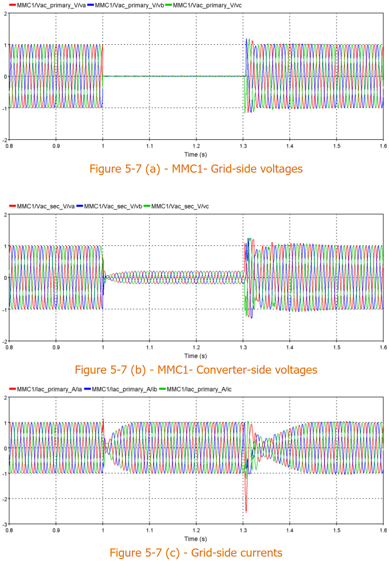
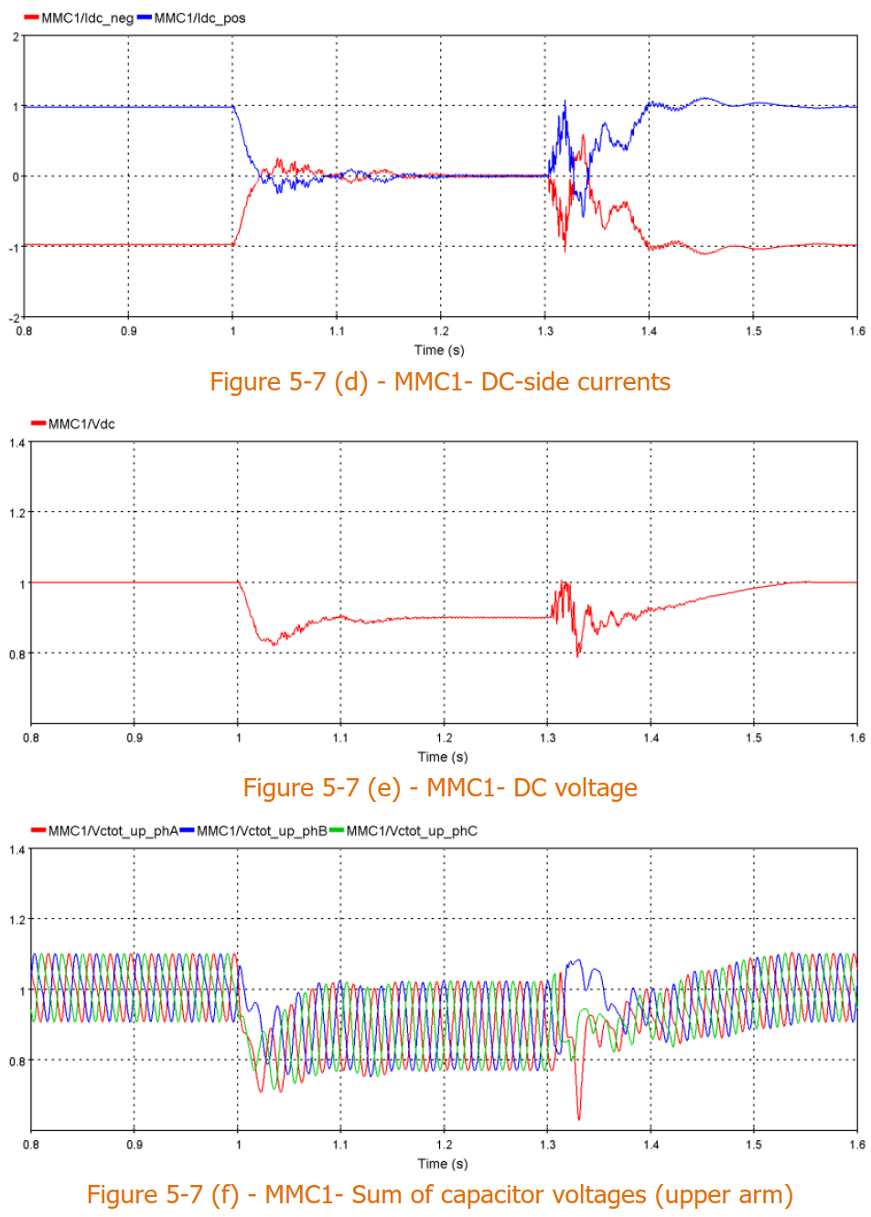
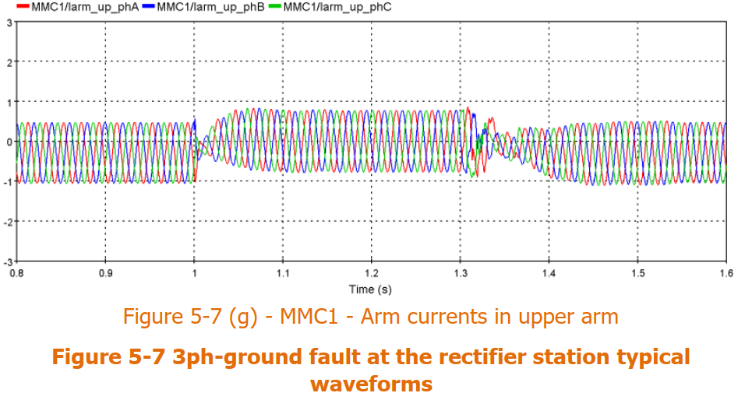
Dynamic Analysis: 3ph-to-GND at the rectifier
CIGRÉ TB 832: GUIDE FOR ELECTROMAGNETIC TRANSIENT STUDIES INVOLVING VSC CONVERTERS

Slide 16
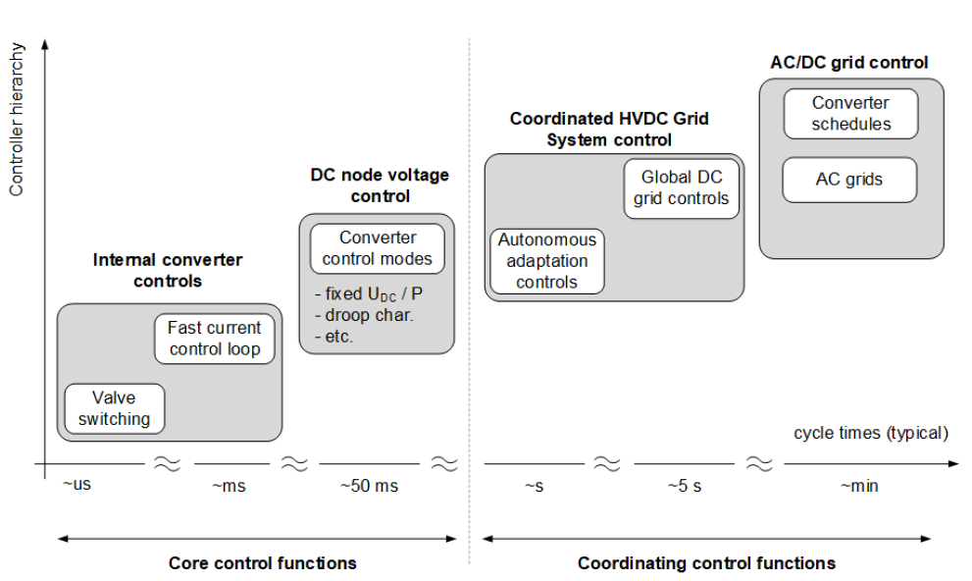
Control hierarchy
CLC/TS 50654-1:2020
HVDC control

Slide 17
Control requirements
Input parameters for the control:
Voltage Measurement
Current measurement
Control functions:
Current control
Voltage control
Reference voltage generation for six voltage sources
Voltage synthetisation by generating switching pulses for individual modules

